Slide 1
Working with the BASH Shell
Chapter 7

Slide 2
Objectives
After completing this chapter, you will be able to:
Redirect the input and output of a command
Identify and manipulate common shell environment variables
Create and export new shell variables
Edit environment files to create variables upon shell startup
Describe the purpose and nature of shell scripts
Create and execute basic shell scripts
Effectively use constructs, special variables, and functions in shell scripts
Use Git to perform version control for shell scripts

Slide 3
Command Input and Output (1 of 2)
BASH shell
Provides a user interface
Interprets commands
Manipulates command input and output
Provided the user specifies certain shell metacharacters alongside the command
File descriptors
Numeric labels that represent command input and command output

Slide 4
Command Input and Output (2 of 2)
For each command that can be manipulated by the BASH shell, there are three file descriptors
Standard input (stdin): refers to information processed by the command during execution
Standard output (stdout): refers to normal output of the command
Standard error (stderror): refers to error messages generated by the command

Slide 5
Redirection (1 of 2)
Redirect stdout and stderr from terminal screen to a file
Use “>” shell metacharacter (redirection symbol)
Can redirect stdout and stderr to separate files using file descriptor numbers
Use “>>” to append additional output to an existing file a file
Use “<“ shell metacharacter to redirect stdin

Slide 6
Redirection (2 of 2)
The tr command: used to replace characters in a file sent via stdin
To save a copy of the Standard Output for later use, you can redirect stdin and stdout for the same command using “<” and “>“
Use different filenames

Slide 7
Pipes (1 of 6)
Send Standard Output of one command to another command as Standard Input
Use the pipe “|” metacharacter
Pipe: series of commands connected by “|” metacharacters
Commonly used to reduce amount of information displayed on terminal screen

Slide 8
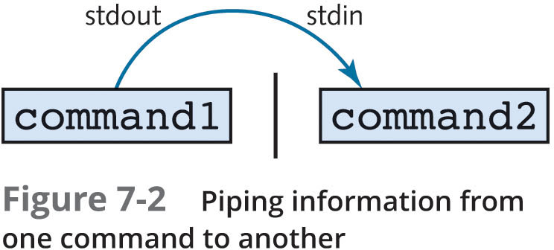
Pipes (2 of 6)
Figure 7-2: Piping information from one command to another

Slide 9
Pipes (3 of 6)
Can use multiple pipes on command line
Pipe information from one command to another command
Filter commands: commands that can take from stdin and give to stdout
The tee command: receives information from stdin and sends that information to a file, as well as to stdout

Slide 10
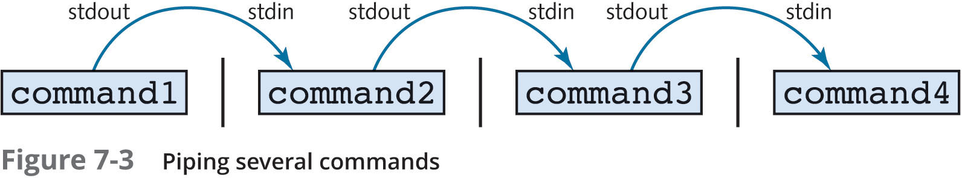
Pipes (4 of 6)
Figure 7-3: Piping several commands

Slide 11
Pipes (5 of 6)
You can combine redirection and piping
Input redirection must occur at beginning of pipe
Output redirection must occur at end of pipe
The sed command: filter command used to search for and replace text strings
Can be used to replace some or all appearances of the search term and to delete specific input lines

Slide 12
Pipes (6 of 6)
The awk command: searches for patterns of text and performs some action on the text it finds
Treats each line of text as a record in a database, and each word in a line as a database field
Uses space or tab characters as delimiters for each field in a line

Slide 13
Shell Variables
Variable: a reserved portion of memory containing information that might be accessed
BASH shell has several variables in memory
Environment variables: contain information that the system and programs access regularly
User-defined variables: custom variables defined by users
Special variables: useful when executing commands and creating new files and directories

Slide 14
Environment Variables (1 of 2)
The set command: lists environment variables and current values
The echo command: view contents of a specified variable
Prefix variable name with the $ shell metacharacter
Changing value of a variable
Specify variable name followed by equal sign (=) and new value
HOME and PWD variables should not be changed

Slide 15
Environment Variables (2 of 2)
PATH variable: one of the most important variables in the BASH shell
Allows users to execute commands by typing the command name alone
If a command is located within a directory that is listed in the PATH variable you can type the name of the command on the command line to execute it
Shell will then find the appropriate executable file on the filesystem
The history command: used view a list of previously executed commands

Slide 16
User-Defined Variables (1 of 2)
Variable identifier: name of a variable
Specify variable identifier followed by equal sign and the new contents
Features of variable identifiers
Can contain alphanumeric characters, the dash character, or the underscore character
Must not start with a number
Typically capitalized to follow convention

Slide 17
User-Defined Variables (2 of 2)
Subshell: shell created by current shell
Most shell commands run in a subshell
Variables created in current shell are not available to subshells
The export command: exports user-defined variables to subshells
Ensures that programs started by current shell have access to variables
The env command: lists all exported environment and user-defined variables in a shell

Slide 18
Other Variables
Not displayed by set or env commands
Perform specialized functions in the shell
UMASK variable
The alias command: creates shortcuts to commands
Can create single alias to multiple commands
Use ; metacharacter

Slide 19
Environment Files (1 of 2)
When exiting the BASH shell, all stored variables are destroyed
Environment files: store variables and values
Executed each time BASH shell is started
Ensures variables are always accessible

Slide 20
Environment Files (2 of 2)
Common BASH shell environment
/etc/profile
/etc/bashrc
~/.bashrc
~/.bash_profile
~/.bash_login
~/.profile
Hidden environment files allow users to set customized variables
To add a variable, add a line to environment file
Use command line syntax

Slide 21
Shell Scripts (1 of 2)
Shell script: text file containing a list of commands or constructs for the shell to execute
May contain any command that can be entered on command line
Hashpling (or shebang): first line in a shell script
Specifies the pathname to the shell that is used to interpret the contents of the shell script

Slide 22
Shell Scripts (2 of 2)
Executing shell scripts with read permission:
Start another BASH shell, specify the shell script as an argument
Executing shell scripts with read/execute permission:
Executed like any executable program
Use echo command to add descriptions and spaces to script output

Slide 23
Escape Sequences (1 of 2)
Character sequences that have special meaning in the echo command
Must use –e option in echo command
Prefixed by \ character

Slide 24
Escape Sequences (2 of 2)
 | Table 7-4: Common echo escape sequences
Escape sequence | Description
\0??? | Inserts an ASCII character represented by a three-digit octal number (???)
\x?? | Inserts an ASCII character represented by a two-digit hexadecimal number (??)
\\ | Backslash
\a | ASCII beep
\b | Backspace
\c | Prevents a new line following the command
\f | Form feed
\n | Starts a new line
\r | Carriage return
\t | Horizontal tab
\v | Vertical tab

Slide 25
Reading Standard Input
Shell scripts may need input from user
Input may be stored in a variable for later use
The read command: takes user input from Standard Input and places it in a variable
Variable name specified by an argument to read command

Slide 26
Decision Constructs (1 of 3)
Most common type of construct used in shell scripts
Alter flow of a program based on whether a command completed successfully or on a decision that the user makes in response to a question posed by the program

Slide 27
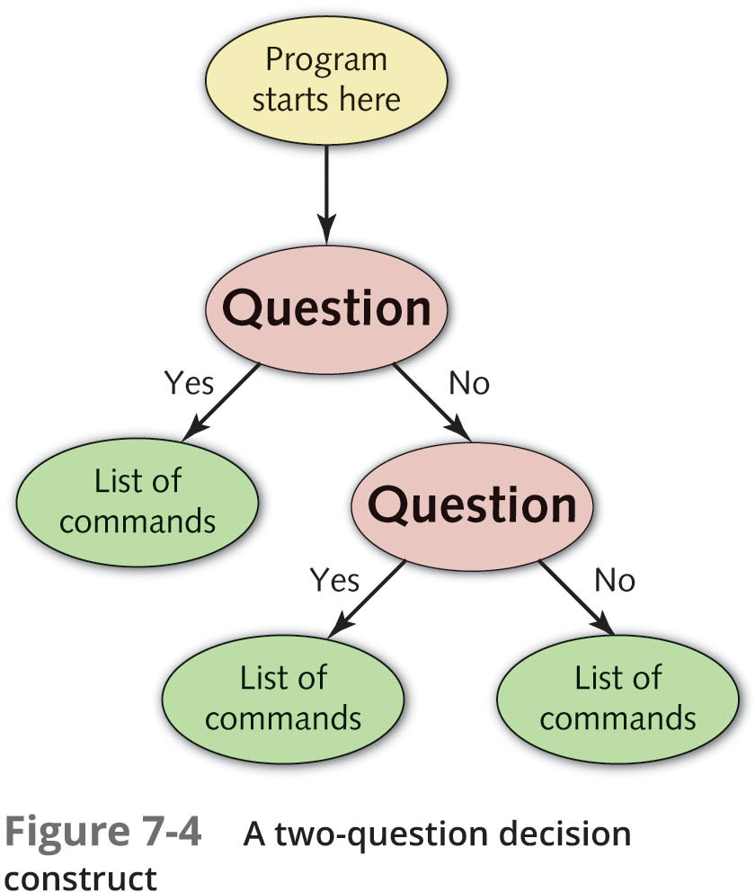
Decision Constructs (2 of 3)
Figure 7-4: A two-question decision construct

Slide 28
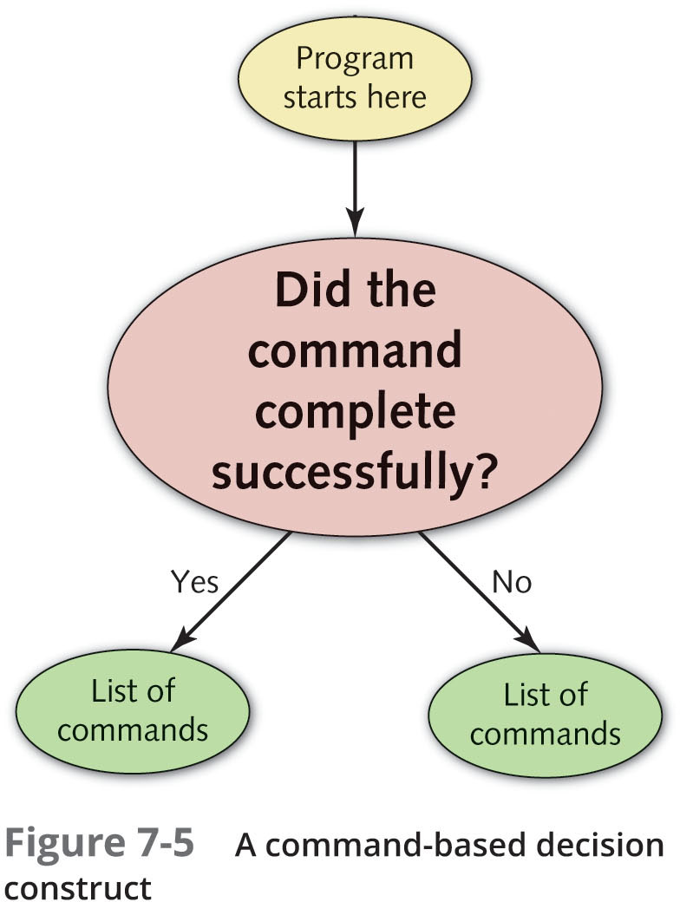
Decision Constructs (3 of 3)
Figure 7-5: A command-based decision construct

Slide 29
The if Construct (1 of 3)
Control flow of program based on true/false decisions
Most common type of decision construct
Common rules governing if constructs
elif (else if) and else statements are optional
Unlimited number of elif statements
Do these commands section may consist of multiple commands
One per line
Typically indented for readability
End of statement must be fi (backward “if”)
This is true portion may be a command or test statement

Slide 30
The if Construct (2 of 3)
Test statement: used to test a condition
Generates a true/false value
Special comparison operators: used to combine test statements
–o (OR)
–a (AND)
! (NOT)

Slide 31
The if Construct (3 of 3)
Table 7-6: Special operators in test statement
Test statement | Returns true if:
[ A = B –o C = D ] | String A is equal to String B OR String C is equal to String D.
[ A = B –a C = D ] | String A is equal to String B AND String C is equal to String D.
[ ! A = B ] | String A is NOT equal to String B.

Slide 32
The case Construct
Compares value of a variable with several different patterns of text or numbers
If a match is found, the commands to the right of pattern are executed
Must end with esac (backward “case”)
Any statements present in the shell script following the case construct are executed after the case construct

Slide 33
The && and || Constructs
Time-saving shortcut constructs
When only one decision needs to be made during execution
Syntax
command && command
command || command
&&: second command executed only if first completes successfully
||: second command executed only if first did not complete successfully

Slide 34
Loop Constructs
Loop constructs: execute commands repetitively
Alter the flow of a program based on the results of a particular statement
Repeats entire program until desired result is reached

Slide 35
The for Construct
Can be used to process a list of objects
Files, directories, users, printers, and so on
During execution, it creates a variable (var_name), sets its value equal to string1, and executes the commands between do and done, which can access the var_name variable
Repeats for all the strings

Slide 36
The while Construct
Begins with a test statement
Commands within the loop construct are executed as long as the test statement returns true
Contains a counter variable
Value changes with each iteration of the loop
Syntax:
while this returns true
do
these commands
done

Slide 37
The until Construct
Opposite of the while construct
Begins with a test statement
Commands within the loop construct are executed until the test statement returns true
Typically contains a counter variable
Value changes with each iteration of the loop
Syntax:
until this returns true
do
these commands
done

Slide 38
Special Variables (1 of 2)
Shell expansion variables
Common for performing command substitution within a shell script as it is easier to read
Also used to perform variable substitution
Positional parameters
Shell script takes arguments when executed on the command line
May be referenced using special variables within the shell script itself
Efficient alternative to prompting the user for input

Slide 39
Special Variables (2 of 2)
Table 7-7: Special built-in shell variables
Variable | Return value
$# | The number of positional parameters
$* | All positional parameter values
$? | Exit status of the last foreground process
$$ | Process ID (PID) of the current shell
$! | Process ID (PID) of the last background process
$- | Flags set in the current shell

Slide 40
Functions
Contain the appropriate commands and constructs at the beginning of the shell script
Used for specific commands and constructs that are used in various places throughout the shell script
Save time
Function library
Single shell script that contains functions only

Slide 41
Version Control using Git
Version control
System that keeps track of the changes that you make to files that you create, such as shell scripts
Git is the most common open source version control system used today
Primarily used to provide version control for software development projects on Linux, macOS, and Windows computers
Performs version control by taking snapshots of what your files look like The files and the associated commits that are managed by Git are stored in a directory called a Git repository
Nearly all Git management is performed using the git command

Slide 42
Summary (1 of 4)
Three components are available to commands: Standard Input (stdin), Standard Output (stdout), and Standard Error (stderr)
Standard Input is typically user input taken from the keyboard, whereas Standard Output and Standard Error are sent to the terminal screen by default
You can redirect the Standard Output and Standard Error of a command to a file using redirection symbols

Slide 43
Summary (2 of 4)
To redirect the Standard Output from one command to the Standard Input of another, you must use the pipe symbol (|)
Most variables available to the BASH shell are environment variables that are loaded into memory after login from environment files
You can create your own variables in the BASH shell and export them so that they are available to programs started by the shell
The UMASK variable and command aliases are special variables that must be set using a certain command

Slide 44
Summary (3 of 4)
Shell scripts can be used to execute several Linux commands
Decision constructs can be used in shell scripts to execute certain Linux commands based on user input or the results of a certain command
Loop constructs can be used within shell scripts to execute a series of commands repetitively
Special variables can be used within shell scripts to access built-in shell information, access positional parameters, and to expand commands and variables

Slide 45
Summary (4 of 4)
Functions can be created within a shell script to store commands and constructs for later execution
Git can be used to provide version control for files on your system that are modified over time, including shell scripts
After changes are made to files within a Git repo, they are normally staged and added to a commit that provides a snapshot of the files at that time

